Slide 1
Discussion
comparing two spatial reasoning solutions
Submission guideline
Provide your team members’ names in slide 2
Provide your answers in slides 4-9.
Rename your pptx file as your team name and upload into LumiNUS.

Slide 2
Team members
List your team members’ full name (as in your course registration)

Slide 3
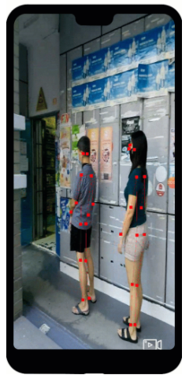
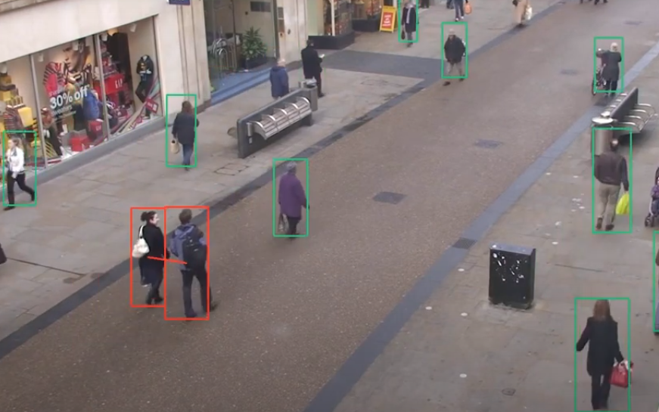
Case study
Solution 1: Landing.AI. https://landing.ai/landing-ai-creates-an-ai-tool-to-help-customers-monitor-social-distancing-in-the-workplace/
Solution 2: FinePose (AI Singapore) https://aisingapore.org/finepose/, https://aisingapore.org/2020/05/finepose-2/

Slide 4
Discussions (1)
 | Solution 1: Langding.ai | Solution 2: AI SG
What is business impact of these solutions? | customers in the manufacturing and pharmaceutical industries

Slide 5
Discussions (2)
 | Solution 1: Langding.ai | Solution 2: AI SG
Definition of ‘social distance’

Slide 6
Discussions (3)
 | Solution 1: Langding.ai | Solution 2: AI SG
Input data What sensory data is used? How to get such data in deployment?

Slide 7
Discussions (4)
 | Solution 1: Langding.ai | Solution 2: AI SG
Technical solution How the social distance is inferred?

Slide 8
Discussions (5)
 | Solution 1: Langding.ai | Solution 2: AI SG
Limitation When will the solution fail?

Slide 9
Discussions (6)
Question. If you are the business owner (e.g., shopping mall manager), provide 1 reason to deploy these solutions, and provide 1 reason to decline these solutions.
 | Solution 1: Langding.ai | Solution 2: AI SG
Agree to deploy
Decline this solution

